Slide 1
CAPA Q2 2010 Review
August 12, 2010
Revised 08-10-10

Slide 2
Agenda
CAPA Review inputs:
  IQA CARs Denise
  Internal process Audits Denise
  2) Internal technical Audits Lenore
  External Audits
  External Rework
  Internal Rework
  Customer Advocacy
  Customer Service Data
  Field Services Steve
  Customer Complaints and CAR Classification Analysis

Slide 3
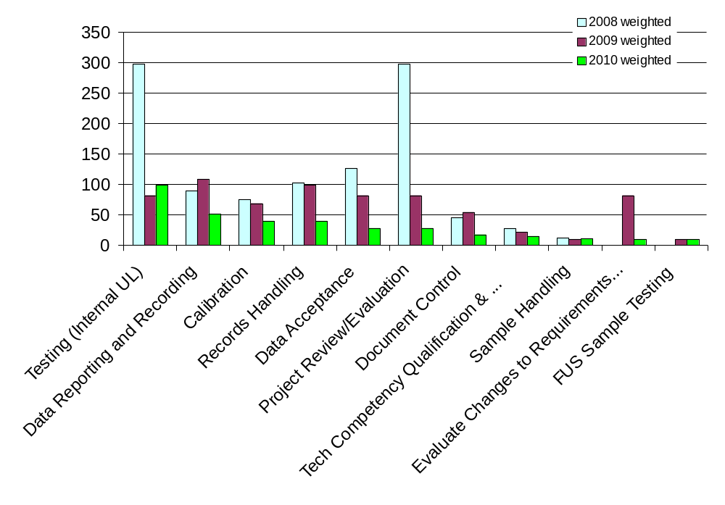
1) IQA CARs – Weighted (severity x volume)
High 9x
Medium 3x
Low 1x
2010 pareto order
Findings & Observations
Source: CAR Database

Slide 4
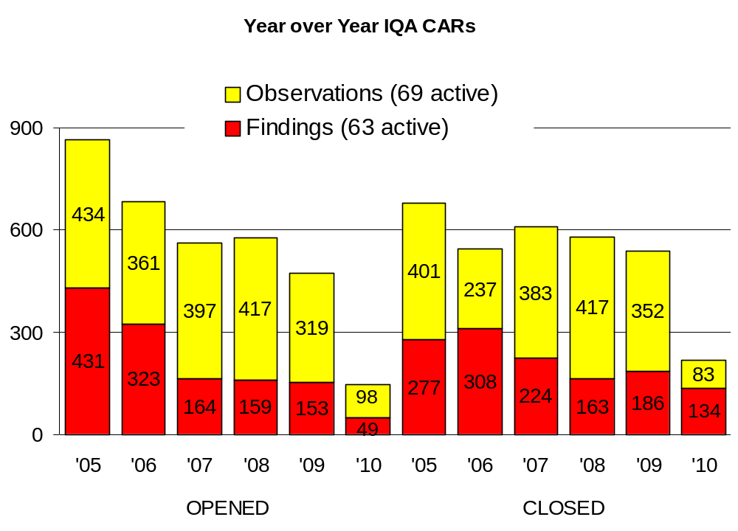
2) Internal Audits (process) – CAR Turnover
2) Internal Audits (process) – CAR Turnover
Analysis / Trend
Low number of YTD 2010 CARs since audits began in March
IQA Audits vs CARs – number of CARs is decreasing as IQA works to obtain stakeholder collaboration to resolve issues that occur across multiple region
Reduction of observation CARs through the use of PDE Work Inventory process and Service Requests
Actions Completed/Underway
Issues
Recommendations
Source: CAR Database

Slide 5
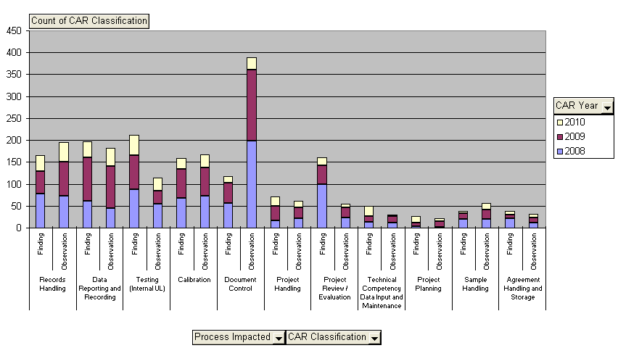
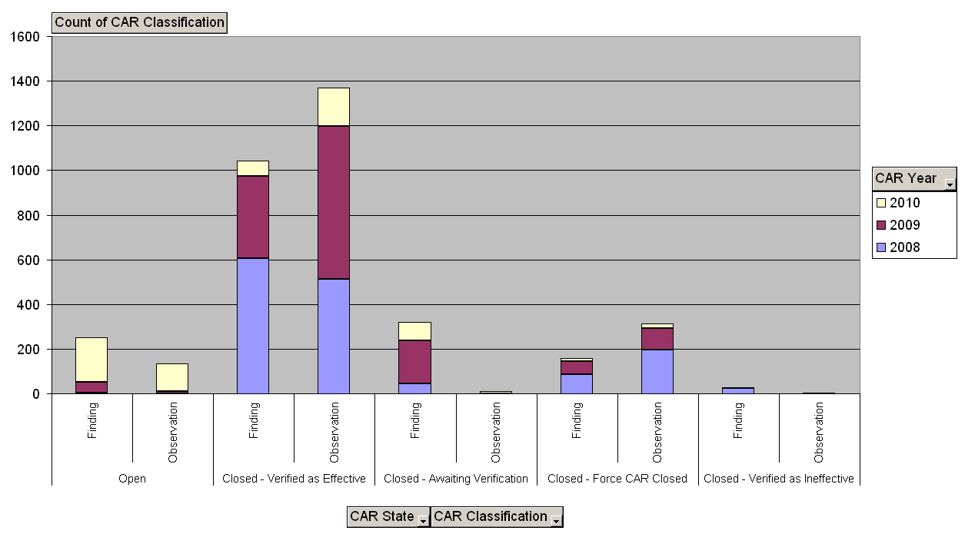
2008-2010 All CARs
by Top 11 Process Impacted
Source: CAR Database
8/5/2010

Slide 6
2008-2010 All CARs
by State
Source: CAR Database
8/5/2010

Slide 7
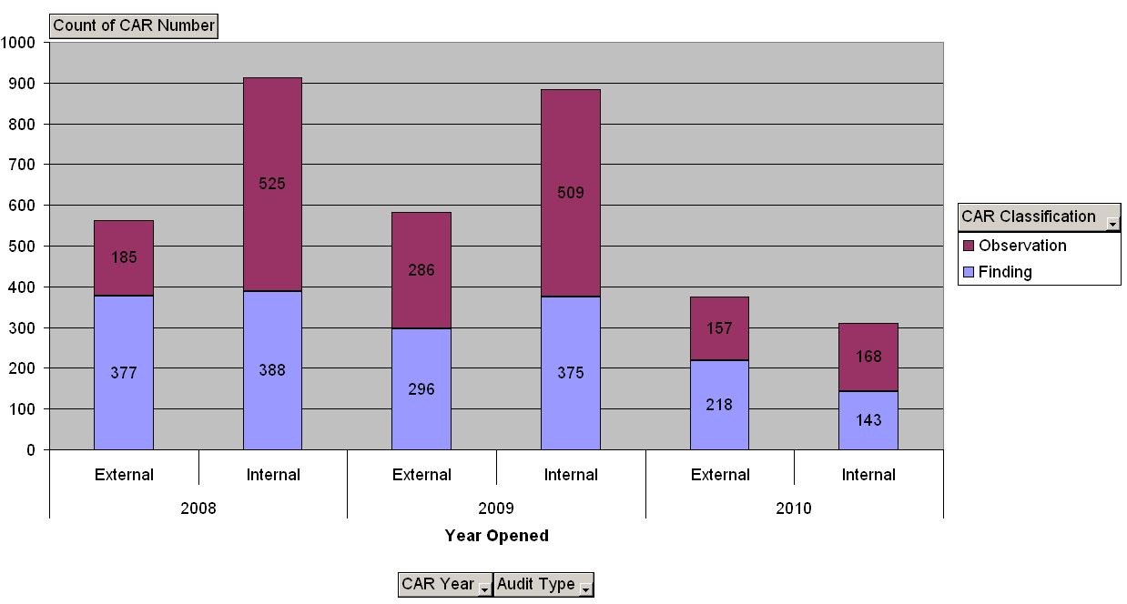
2008-2010 CARs
by Year Opened, CAR Classification, Audit Type
Source: CAR Database
8/5/2010

Slide 8
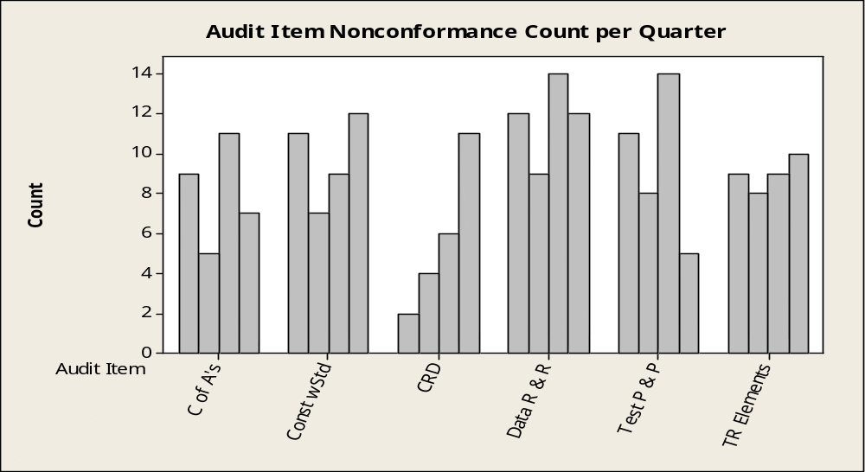
Internal Audits – Technical Audits
Projects Audited
Q2-Q3 ’09 Q4 ’09 1Q ’10 Q2 ’10
25 20 30 28
Q2-Q3 ’09
Q4 ’09
Q1 ’10
Q2 ‘10
Notes:
Overview:
103 full technical audits completed
Samples were selected from the 14 Industry Sector/Service Lines and 39 NRTL/SNAP sites
14 projects complied with all requirements (13%)
Delayed Q3 projects due to CAS boost
Audit Item Nonconformance Count:
CofA’s – 5 to 11 (25% to 44%)
Const complies with the Standard – 7 to12 (30% to 44%)
CRDs – 2 to 11 (8% to 39%)
Data Reporting and Recording – 9 to 14 (43% to 48%)
Test Plan and Procedure - 5 to 14 (18% to 47%)
Required Elements in Test Record – 8 to 10 (30% to 40%)

Slide 9
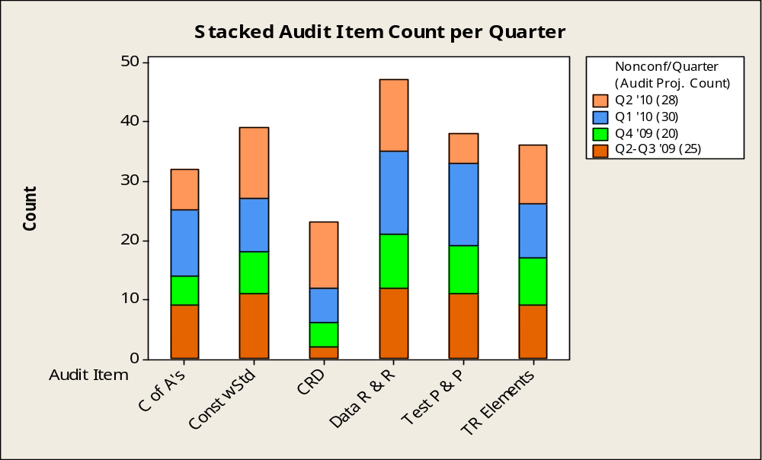
Internal Audits – Technical Audits
Notes:
Total Count per Audit Item:
CofA’s – 32 (31% of audited projects)
Const complies with the Standard – 39 (38% of audited projects)
CRDs – 23 (22% of audited projects)
Data Reporting and Recording – 47 (46% of audited projects)
Test Plan and Procedure - 37 (36% of audited projects)
Required Elements in Test Record – 36 (35% of audited projects)
Technical Auditors:
2009 – Projects were audited by L3/L4 staff within region
Q1 2010 – Majority of project audits were cross-regional
Q2 2010 – Mix of inter and cross-regional audits

Slide 10
Internal Audits - Technical Audits
I. Actions Underway:
    CARs/SRs established to address confirmed non-conformances
    Reviewing audit results with ULU to drive NSEP improvements and other staff training
    Determining availability of standardized documents (i.e. GFL, UltraLink)
Recommendations:
    With stakeholder input, establish prioritized list for creating/updating standardized documents
    Establish means to communicate results to CAS staff
    Continue ramping up the technical audits
    Pilot In-Process audits focusing on areas of nonconformance
Issues:
    Availability of CAS resources to create/update documents and conduct technical audits
Notes:
Ramp up technical audits to drive improved quality, increase technical excellence, drive consistency and reinforce expectations.
CSI III Rollout:
Plan on starting to schedule In-Process audits with the pilot in October
Incorporate full technical audits in December

Slide 11
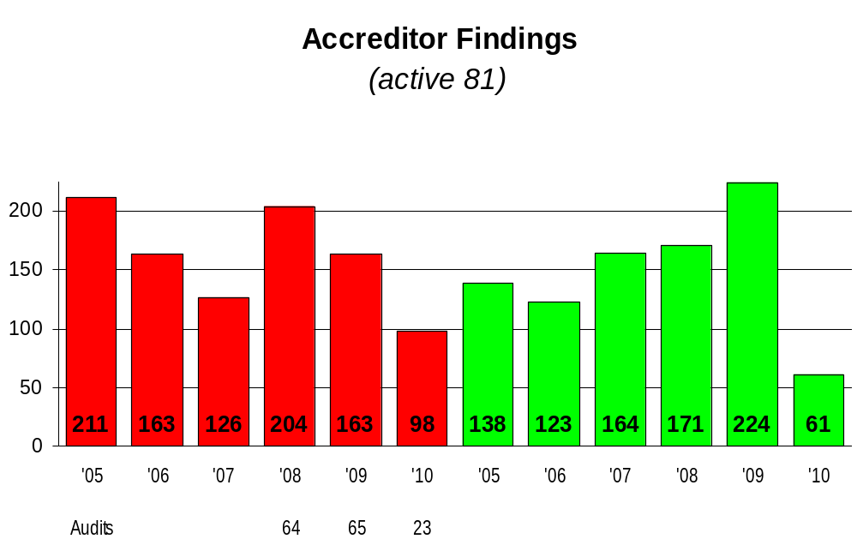

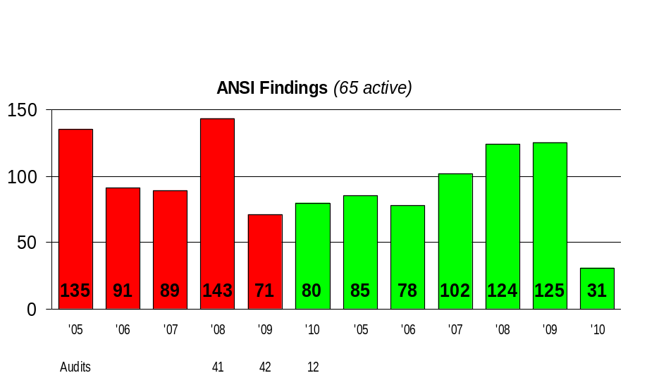
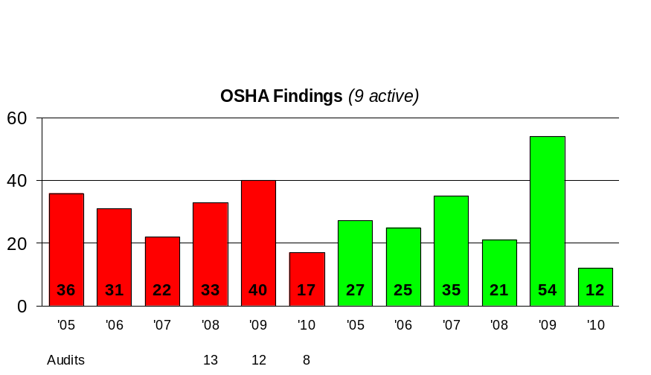
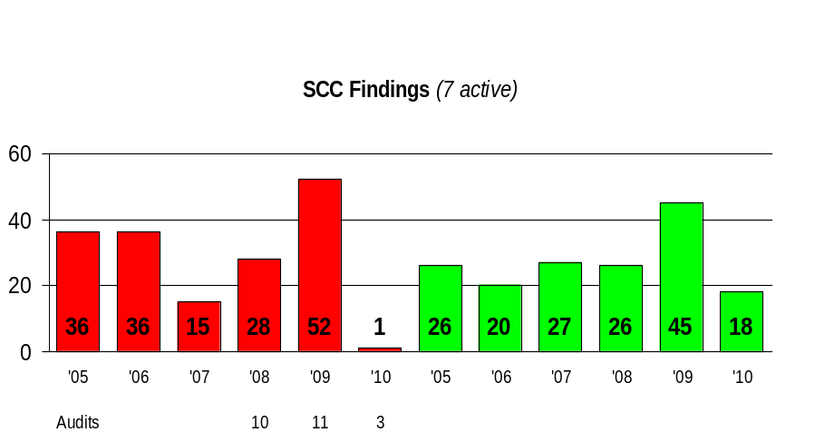
3) External Audits – Accreditor Finding Turnover (YoY through year end 2009)
Source: CAR Database

Slide 12
3) External Audits – Accreditor Finding Turnover (YoY thru year end 2009)
Trend / Analysis
Accreditors are documenting issues on a per site basis repeat finding
Accreditors observing year-over-year repeat findings (keep writing the same finding)
Correlation between internal and external audit findings – issues found internally that are not resolved become Accreditor findings
Actions Underway
L6S Technical Accuracy of Certifications (ID:00391)
Issues
Recommendations
Source: CAR Database

Slide 13
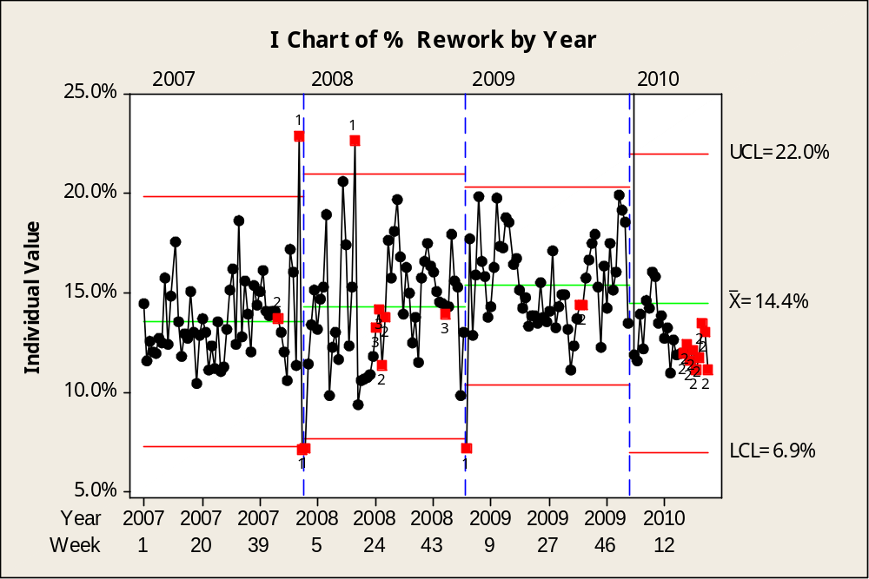
4) External Rework
On average,14.4% SR are Corrections with Review submitted by customers
Legend
3 std Deviations from center
9 points on the same side of the center line
6 consecutive points +/-
Actions Underway:
L6S Technical Accuracy of Certifications (ID:00391)
L6S Corrections with Review (CWR) handled by CS & RTC (ID:00460)
Issues
Recommendations:
Source: Ext Rework – from datamart Global CAS Dashboard
http://ulreports.ul.com/reports/Pages/Folder.aspx

Slide 14
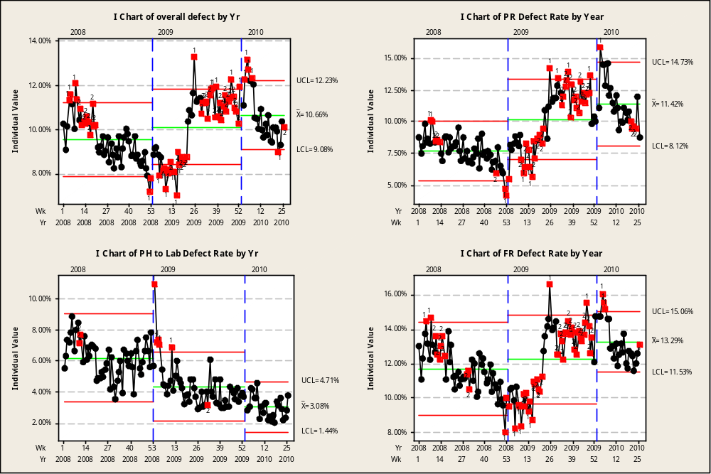
5) Internal Rework – by stage

Slide 15
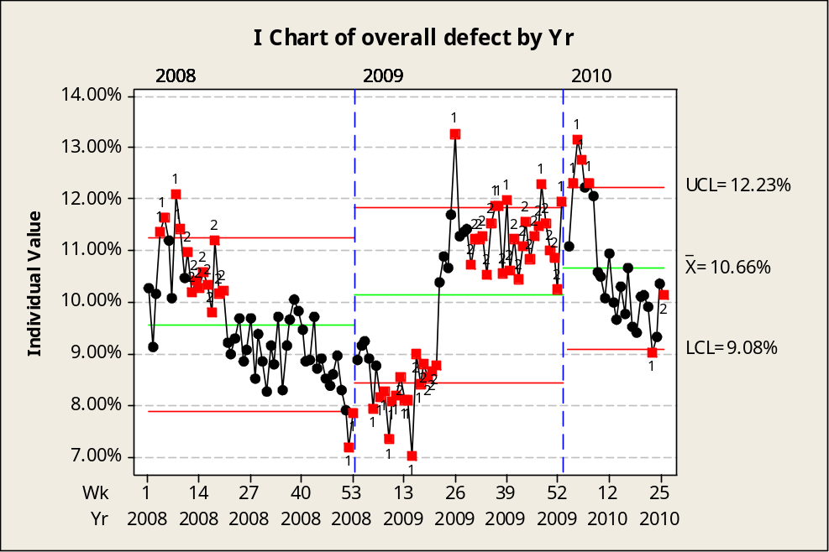
5) Internal Rework – overall
On average,10.7% of jobs are reported as returned in 1H 2010
Actions Underway:
CORE CSI 3
L6S Asia Hi-Tech SBU Rework Analysis - DMA (ID:00301)
L6S Reduction of RTH Projects of 3618AWTR, (ID: 00390
L6S Reduction on RTH projects during PR phase (ID:00436)
L6S Corrections with Review (CWR) handled by CS & RTC (ID:00460)
L6S Rework due to reviewers' preferences Appliances (ID:00475)
L6S Reduce final review rejects in EULA Power & Controls (ID:00526)
L6S Return to Handler (ID:00565)
L6S Reduce the number of Project defects (ID:00580)
Issues
Recommendations:
Source: Internal Rework – datamart SQL query
ULTrack Database

Slide 16
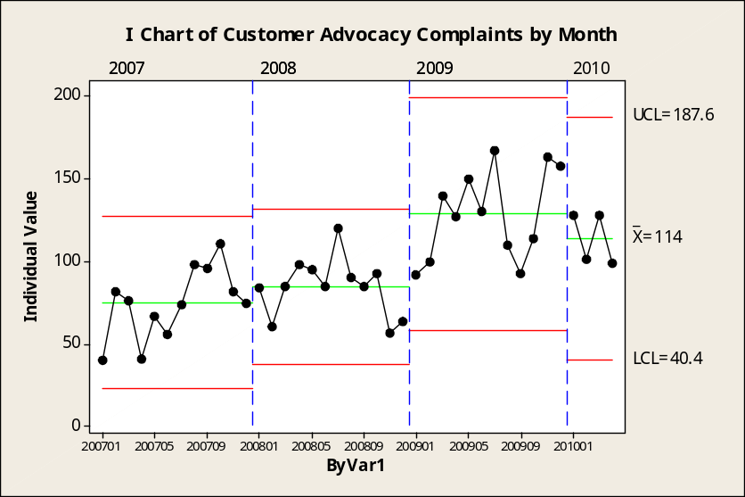
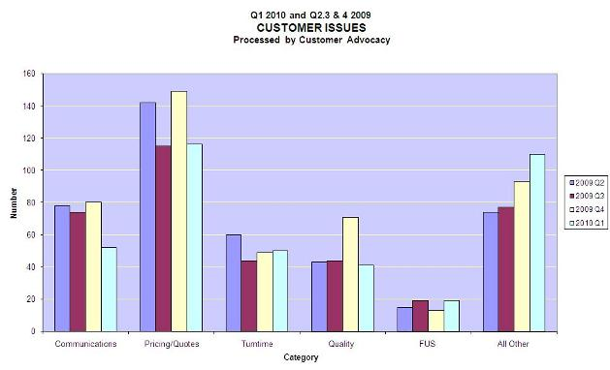
6) Customer Advocacy Complaints
Update pending
Trends in customer issues during the 1st Quarter, 2010 included:
Of the total Q1 Pricing comments, 40 were directly related to the quote process.
There was a noted decrease in total Quality issues for the quarter.
388 customer issues were reviewed and processed by Customer Advocates (Europe, Asia, and North America) during the quarter vs. 455 customer issues during the last quarter of 2009.
Issues:
Actions Under Way:
L6S Project Global Complaint Documentation and Data Integrity (ID:00318)
Recommendations:
Source: Customer Advocacy

Slide 17
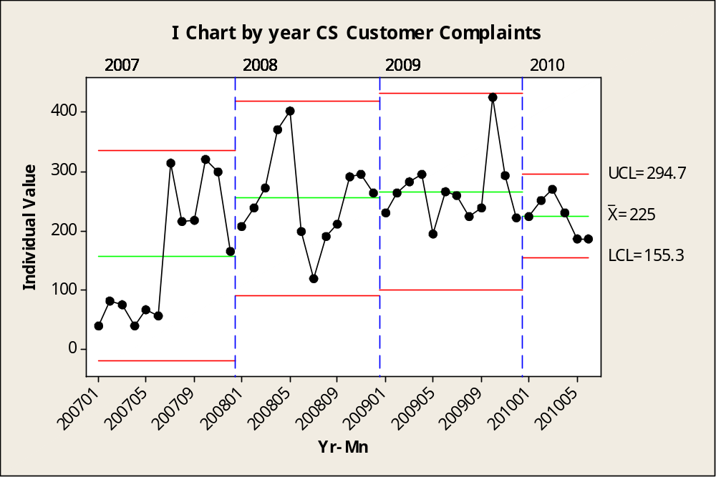
7) Customer Complaints – Customer Service Data
Quote Pricing, FUS Fees, and VNs are top 3 Complaints (This graph also includes complaints that were created but were eventually cancelled.)
Actions Under Way:
  L6S Project Global Complaint Documentation and Data Integrity (ID:00318)
Recommendations:
Source: corporate.ul.com/library/cs/docs/FAQ/MonthlyComplaintReport.xls

Slide 18
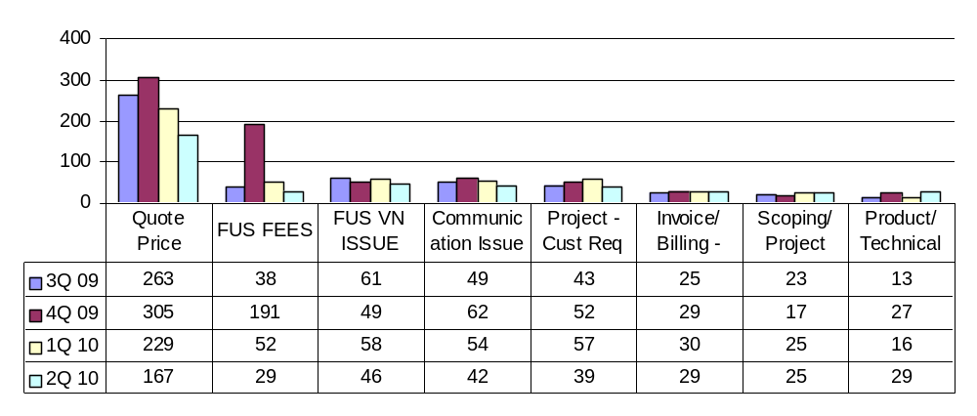
7) Customer Complaints – by problem code (1 of 2)

Slide 19
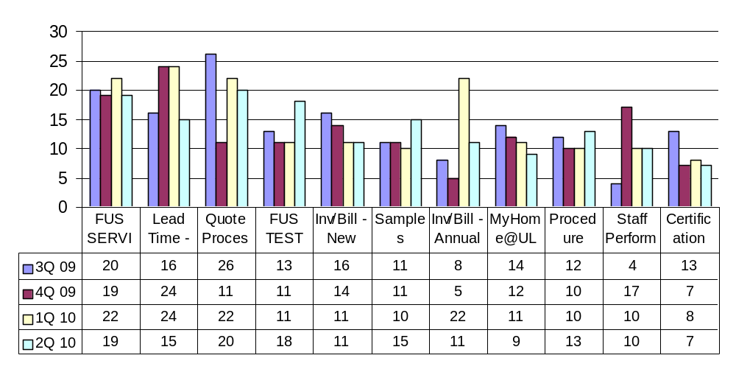
7) Customer Complaints – by problem code (2 of 2)

Slide 20
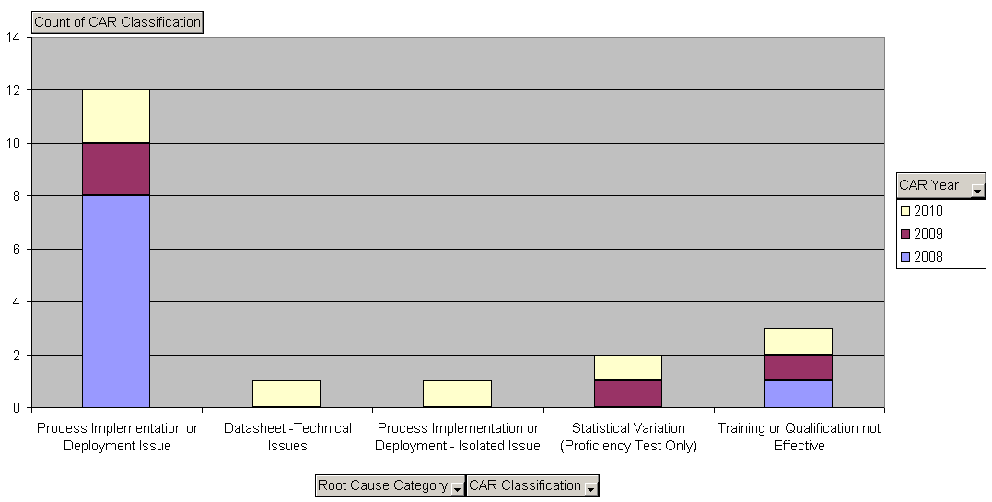
2008-2010 Customer Complaint CARs
Continuing Issues by Root Cause Category
Source: CAR Database
8/5/2010

Slide 21
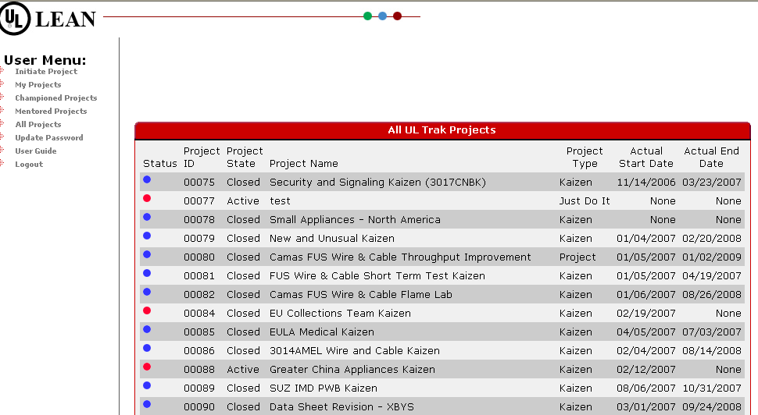
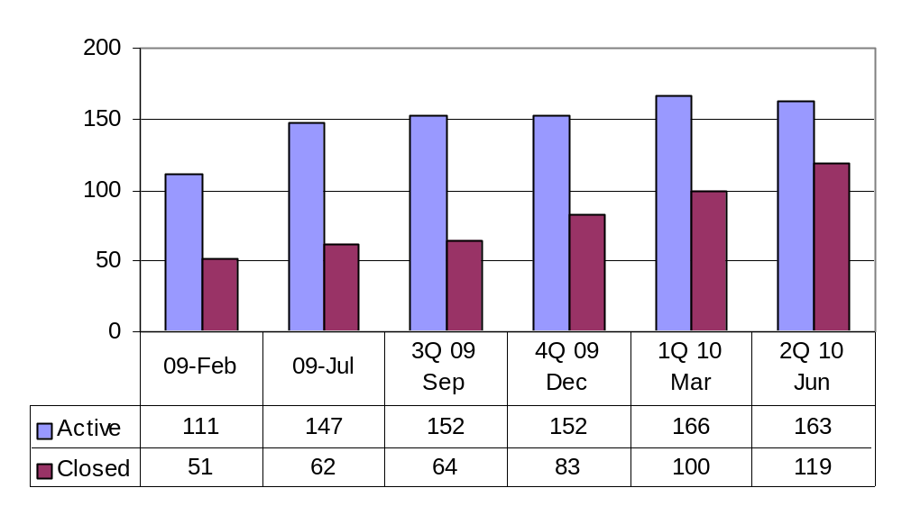
L6S Projects on UL Track
Source: UL Track

Slide 22
CAPA Q2 2010 Review
Field Services
Customer Complaints and
CAR Classification Analysis
8) Field Services
July 2010

Slide 23
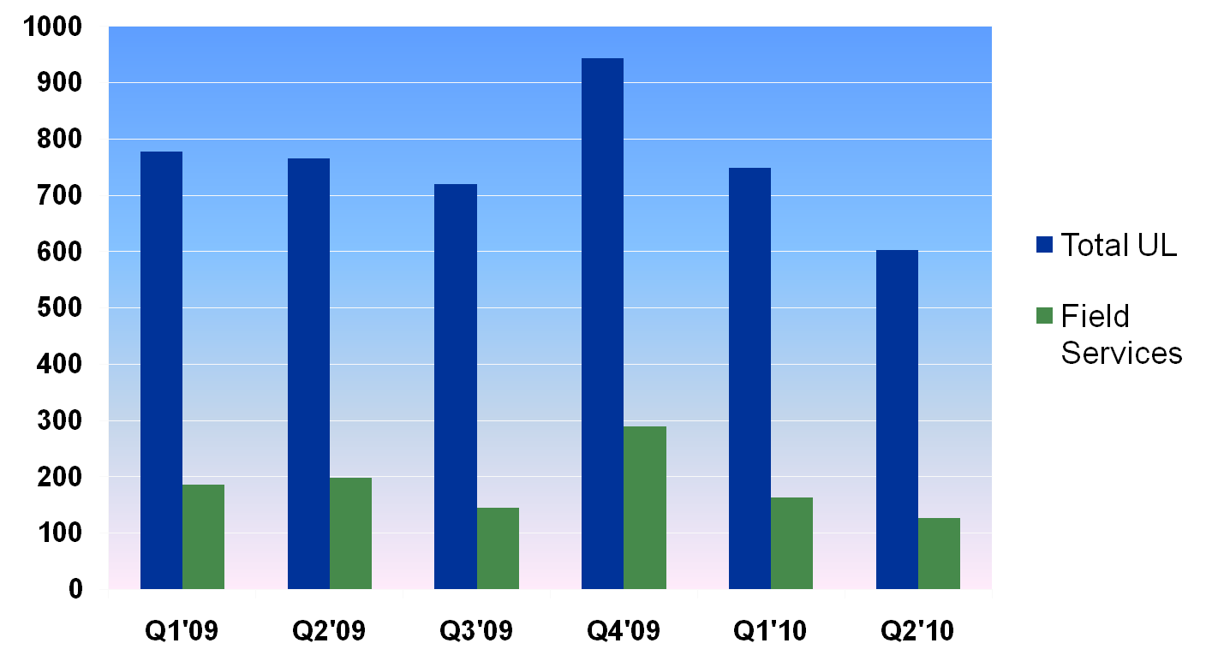
Customer Complaints – Total UL vs. Field Services
Notes:
CPC Annual Management Review
2007-03-28
Underwriters Laboratories Inc.
Page <number>
Q1'09 Q2'09 Q3'09 Q4'09 Q1'10 Q2'10
Total UL: 778 765 720 944 748 602
Field: 186 198 145 289 163 126
% Total: 24% 26% 20% 31% 22% 21%
Or 2009= 25%, 2010 YTD=21%
CPC Annual Management Review
2007-03-28
Underwriters Laboratories Inc.
Page <number>

Slide 24
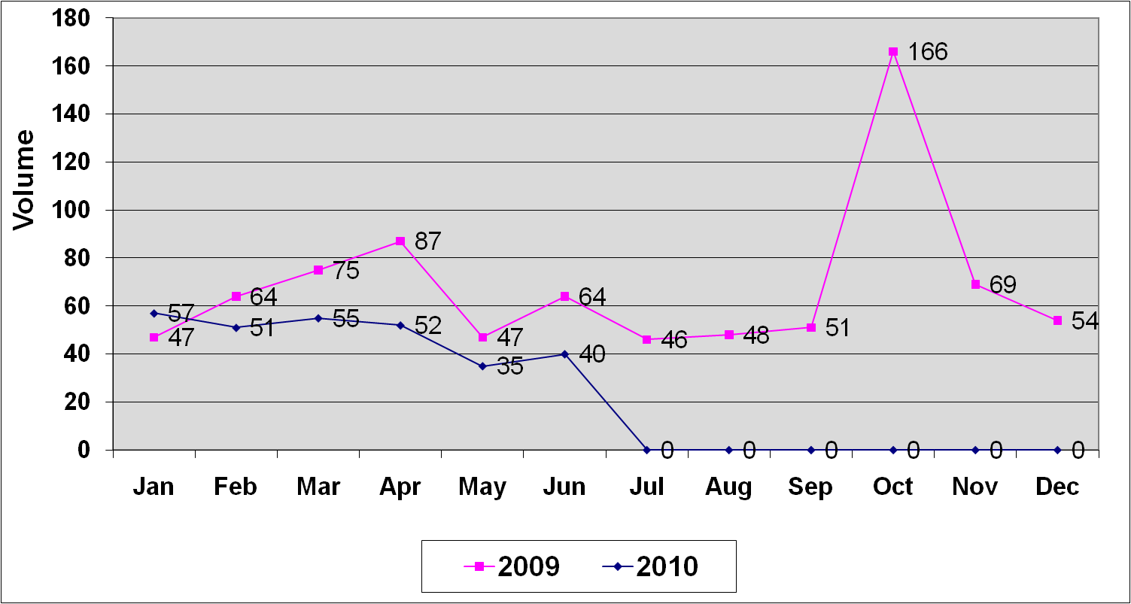
Customer Complaints – Field Services Trend by Month & Year
Source: corporate.ul.com/library/cs/docs/FAQ/MonthlyComplaintReport.xls
Notes:
CPC Annual Management Review
2007-03-28
Underwriters Laboratories Inc.
Page <number>
Customer Complaint Volume is trending favorably 2010 YTD vs. 2009
CPC Annual Management Review
2007-03-28
Underwriters Laboratories Inc.
Page <number>

Slide 25
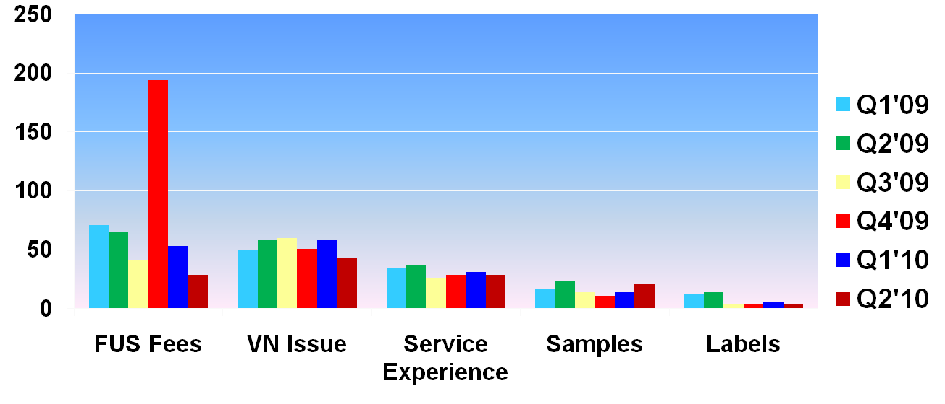
Customer Complaints – Field Services by category
Q2 10 | 29 | 43 | 29 | 21 | 4
Q1 10 | 53 | 59 | 31 | 14 | 6
Q4 09 | 194 | 51 | 29 | 11 | 4
Q3 09 | 41 | 60 | 26 | 14 | 4
Q2 09 | 65 | 59 | 37 | 23 | 14
Q1 09 | 71 | 50 | 35 | 17 | 13
Notes:
CPC Annual Management Review
2007-03-28
Underwriters Laboratories Inc.
Page <number>
The spike in FUS FEES complaints in Q4 ’09 associated with announced increase in 2010 fees
These complaint “by category” numbers are based on an analysis of all Field Service complaints for 2009 and 2010 YTD
They do not align exactly with those shown previously since some have been adjusted slightly based on the following:
For 2009: 47 of 3207 complaints (~1.5%) were re-adjusted to reflect more accurate category
For 2010: 24 of 1350 complaints (~1.8%) were re-adjusted to more accurate category
Practical impact of the adjustment is negligible; these numbers match previous slide 13 & 14 more or less, within + / - a few complaints;
Category “Service Experience” here is slightly higher in volume comared with slide 14 since this slide includes several complaints from “Staff Performance” and “Communication” categories that relate to Field Operations
CPC Annual Management Review
2007-03-28
Underwriters Laboratories Inc.
Page <number>

Slide 26
Customer Complaints – Field Services Summary Actions
  Actions Underway –
  VN Phase 3 Launch – June 21, 2010
    Includes both Field Staff and Customer Training
  New FUS Sample Tracking Database launched
    For Plastics QMTT and QMTM
  Issues –
  Based on overall favorable trends, no “critical” issues for Field Service related customer complaints
  Recommendations –
  Feedback to Customer Service will be provided to show more accurate complaint category

Slide 27
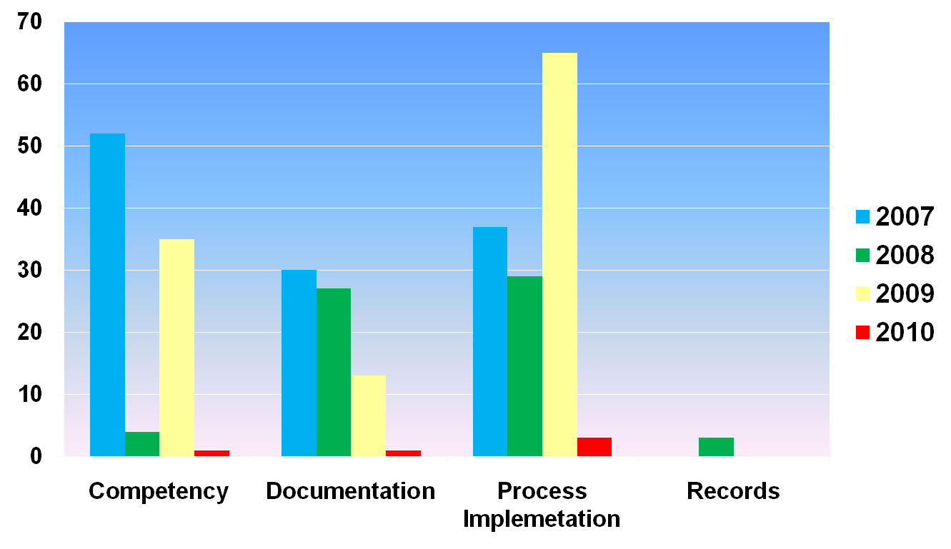
Internal Audits (GFO IQA & ITA) CAR Classification by category
Notes:
CPC Annual Management Review
2007-03-28
Underwriters Laboratories Inc.
Page <number>
Classification definitions provided on next slide.
Total CARs: 300 (134 – Process, 92 – Competency, 71 – Docs, 3 – Records)
Total Corporate IQA: 129
Total GFO Tec Audits: 171
Note: There were 24 CARs not shown in the chart that were determined to be no non-conformance.
CPC Annual Management Review
2007-03-28
Underwriters Laboratories Inc.
Page <number>

Slide 28
CAR Classification Definitions
  Process Implementation - Not carried out as intended (practice did not meet requirements) or expected.
  Competency - Staff not demonstrating the required competency for the work performed. The personnel facilitating the process did not have the required competency or did not demonstrate the appropriate level of awareness or knowledge to adequately comply with the requirements, expectations or intent of the process.
  Documentation - Not adequate, (SOPs, WIs, etc.) or not at the required revision level during use (SOPs, STDs, Procedures, Forms, etc.).
  Records - Not maintained, not complete, not processed in accordance with requirements (includes any records such as training, competency, reports, plans, IFS etc.).

Slide 29
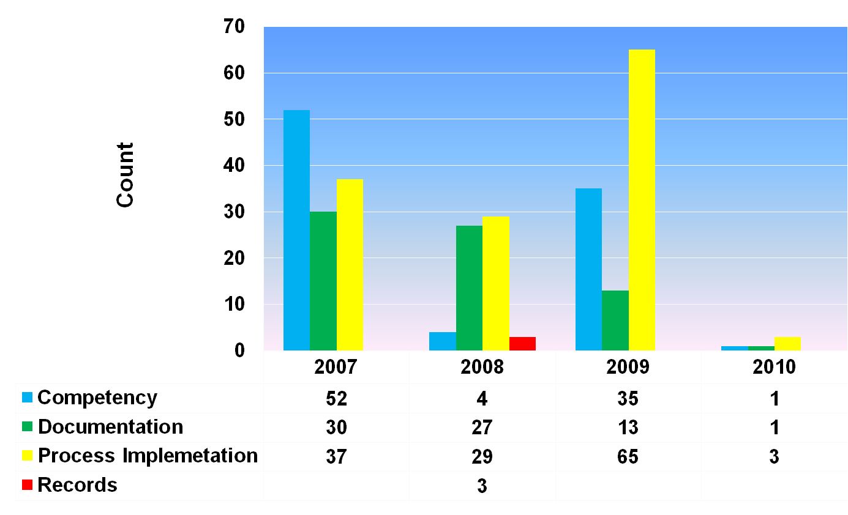
Internal Audit CARs by Classification, by Year and Count Values

Slide 30
GFO CAR Classification and Current Actions
Process Implementation - Actions taken / Planned:
  Updated document distribution process (DDS)
  Improved access methods for locating requirements (DDS)
  Updated processes for improved customer focus
    VN Phase 3 Re-design
    PRV Team reviewing process
  Automation / IT enhancements
    New FUS Sample Database tracking launched for Plastics
  Improved Ongoing awareness efforts
    Expanded use of GFO QA Department Home Page
Competency – Actions taken / Planned:
  More active supervisory / field representative engagement
  Improved communications / enhanced awareness of expectations
  Enhanced competency process & associated training
  Updating SOP’s focusing more on process intent, best practices and checklists
  Regional management re-alignment / re-organization
Notes:
Consistency - When staff do not carry out the process as intended they are often not consistent in their methods (IC, regionally, globally). The following activities and initiatives are also focused at improving consistency so that out processes are carried out as intended:
(1) - Internal Tech Audits - Just by the nature of these audits we are looking at our process globally to uncover any regional differences.
(2) - Updating SOPs with process intent, BPs and checklists (could remove this from under competency) - Sometimes the inconsistency is caused by a misunderstanding of the requirements
(3) - Clarification of process requirements via SOP updates - Again misunderstanding in requirements and expectations lead to in consistency
(4) - FMG and FOM meetings and management reviews - These forums allow us to discuss regional differences and differences between ICs so that we can calibrate and get on the same page.
(5) - Training - For example the training for VN Phase II and II, witness testing, etc. communicate the same message to all staff to improve consistency.
(6) - FAQs - FAQs posted on the FS webpage provide another tool to improve consistency, especially in this gray areas where more guidance is necessary.
(7) - DFRs - The role of the DFRs and PDFs should be to also promote consistency for the categories for which they are responsible.

Slide 31
GFO CAR Classification and Current Actions
Documentation – Actions taken:
  Planned “Process Intent” format enhancement for SOPs
  Developed experience in creating process documentation focusing on process intent
  Expanded personnel involvement and collaboration in process development & process enhancements
Records – Actions taken:
  Developed FO Records SOP for all Field Programs
  Improved process awareness
  Automation / IT enhancements
  Clarified processes and requirements via SOP updates
Issues / Recommendations:
  Based on overall trends, no “critical” issues identified
  Monitor progress on initiatives through FOM / FMG meetings and monthly status updates

Slide 32
END

Slide 33
Backup Materials

Slide 34
2008-2010 All CARs
by Top 11 Process Impacted
Source: CAR Database
8/5/2010

Slide 35
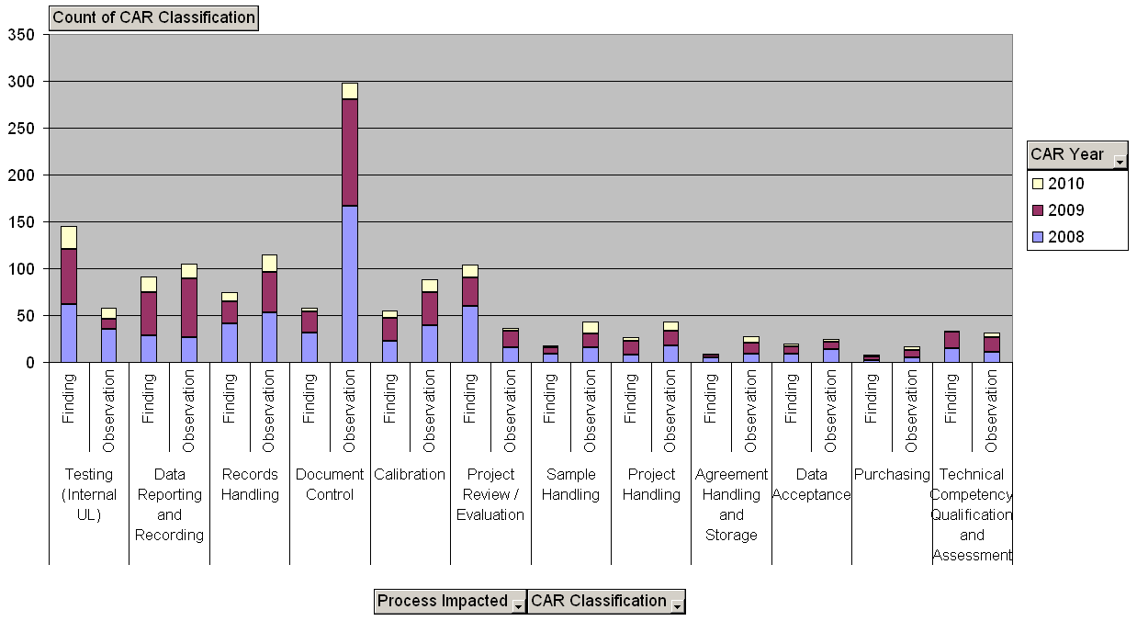
2008-2010 Internal CARs
by Top 12 Process Impacted
Source: CAR Database
8/5/2010

Slide 36
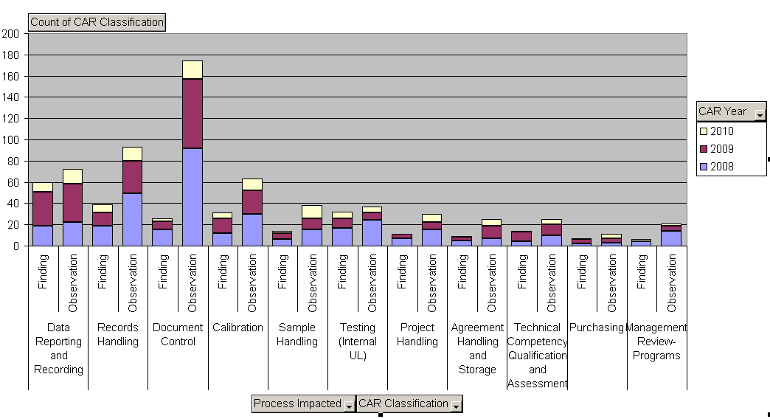
2008-2010 Corporate IQA CARs
by Top 11 Process Impacted
Source: CAR Database
8/5/2010

Slide 37
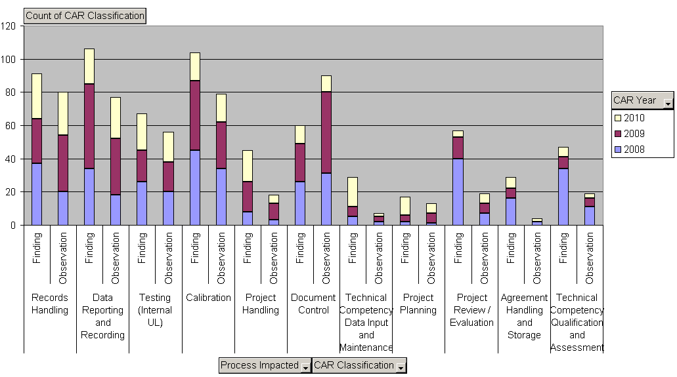
2008-2010 Accreditor CARs
by Top 11 Process Impacted

Slide 38
2008-2010 All CARs
by State
Source: CAR Database
8/5/2010

Slide 39
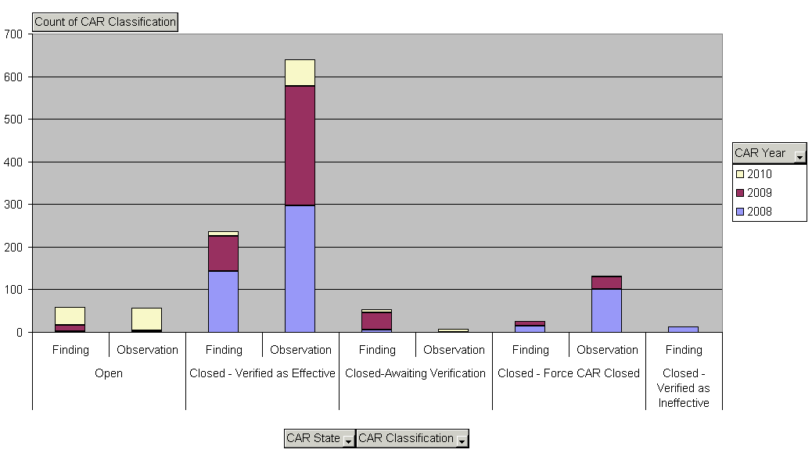
2008-2010 IQA CARs
by State

Slide 40
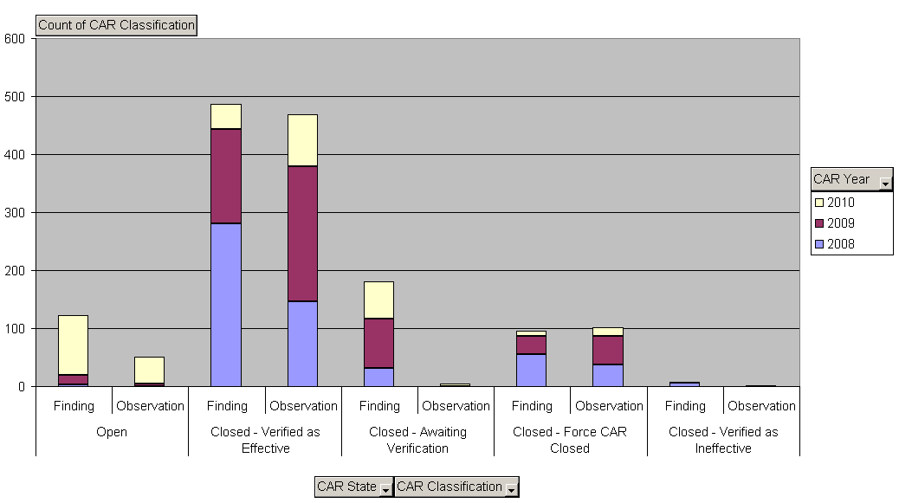
2008-2010 Accreditor CARs
by State

Slide 41
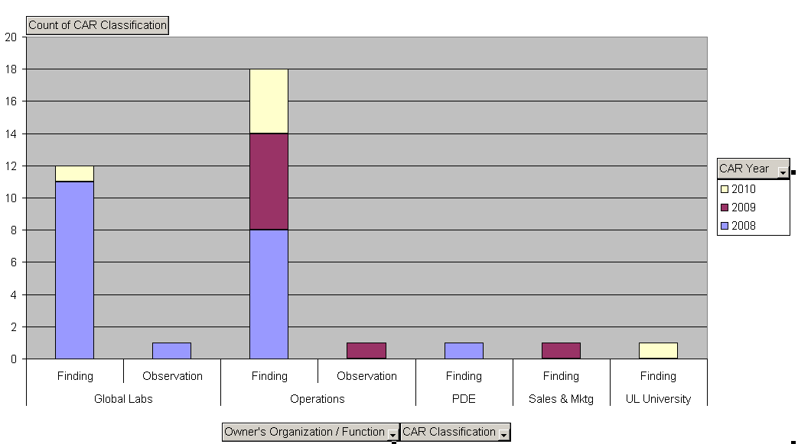
2008-2010 Customer Complaint CARs
by Organization / Function
Source: CAR Database
8/5/2010

Slide 42
2008-2010 Customer Complaint CARs
Continuing Issues by Root Cause Category
Source: CAR Database
8/5/2010

Slide 43
2008-2010 CARs
by Year Opened, CAR Classification, Audit Type
Source: CAR Database
8/5/2010

Slide 44
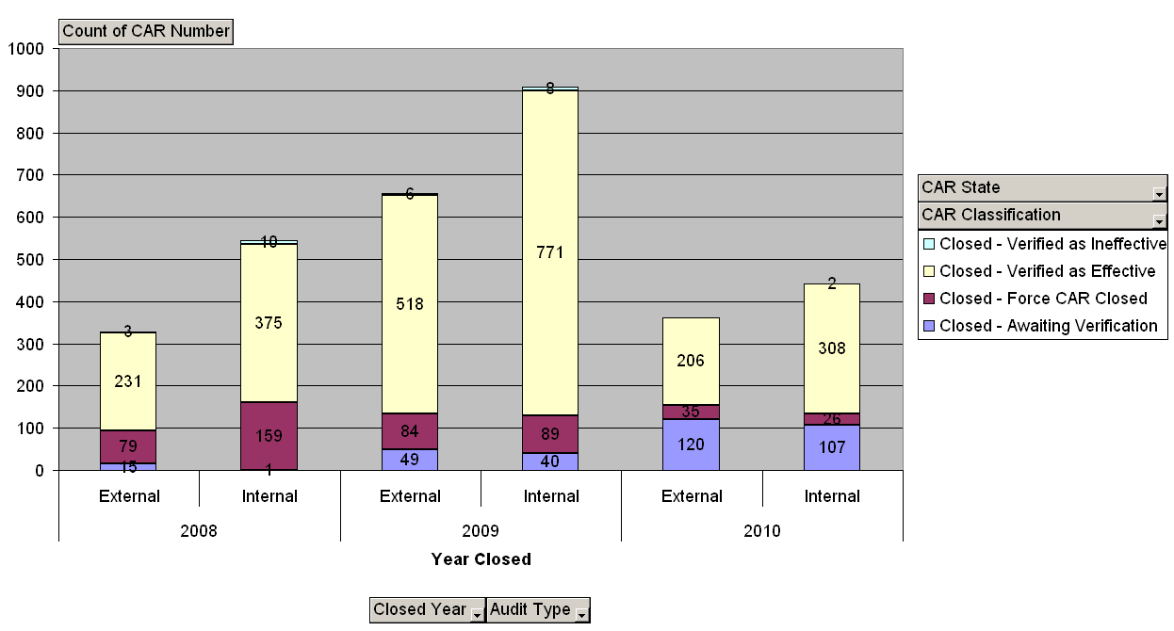
2008-2010 Closed CARs
by Year Closed, Current State, Audit Type
Source: CAR Database
8/5/2010

Slide 45
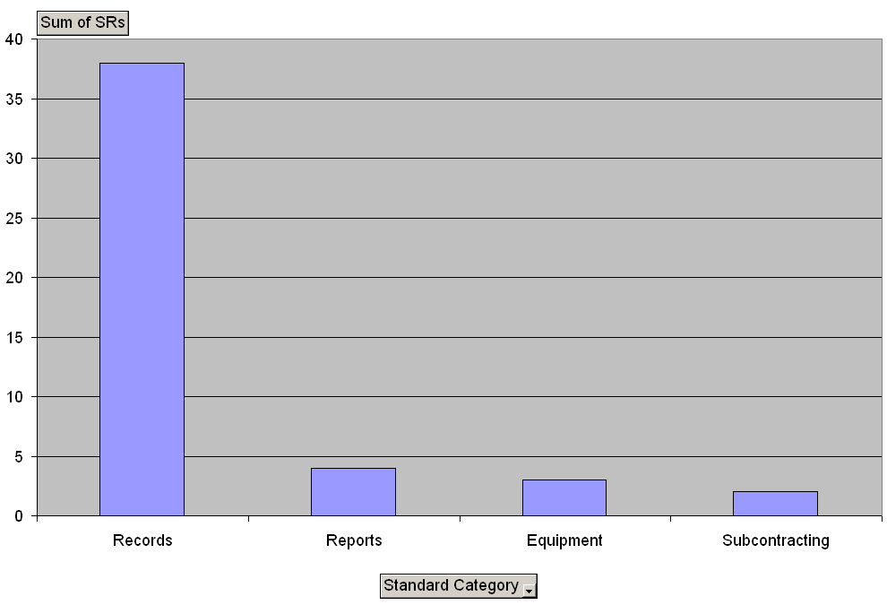
2010 Service Requests
Generated from IQA Audits
by Standard Category
Source: CAR Database
8/5/2010

